Slide 1
Hardforq Cafe
An Stage & Role Approach to Onboarding https://iohk.io/en/blog/posts/2020/11/13/the-general-perspective-on-staking-in-cardano/
Notes:
Who are you
What do you do
Why does it matter
Why should people care

Slide 2
4 Questions
Who are you
What do you do
Why does it matter
Why should people care
The Hardforq Kafe is…

Slide 3
Cardano Depends on a Healthy Stake Pool Network

Slide 4
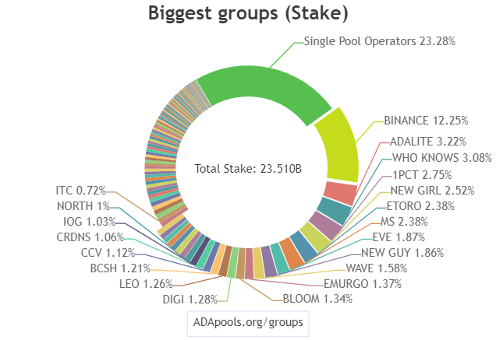
Grouping of Stake Pools - https://adapools.org/groups

Slide 5
Actors in the Stake Pool Network
IOG, CF, Emurgo, DCF, cFund
Exchanges
Wallets
MPOs
SPOs
ADA Holders(bottom-up)
Actors Can have Many Roles

Slide 6
Roles
SPOs & Stake Holders
Voters
Proposers
CAs
vCAs
Whales
Challenge Teams
Circle-subcircle
dReps
Role Identification & Representation
These are all represented by one thing - a wallet
It all begins and ends in a wallet

Slide 7
The Stages
Insight Sharing
Submit Proposals
Refine
Finalize
Assess
AssessQ&A
Governance
Insight Retrospective

